Slide 1
The Gift of Apostle, Wisdom & Knowledge
What are they?
Are they here today?
Dr. Rick Griffith • Jordan Evangelical Theological Seminary • BibleStudyDownloads.org

Slide 2

Spiritual Gifts
How Long Will They Last?

Slide 3
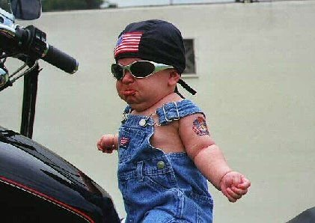
Does this gifts study make you feel like you're not ready just yet?

Slide 4
Views on the Duration of Gifts
14-15
14
1. No gifts passed away (non-cessationist)
2. All gifts passed away (total cessationist)
3. Some gifts passed away (partial cessationist)

Slide 5
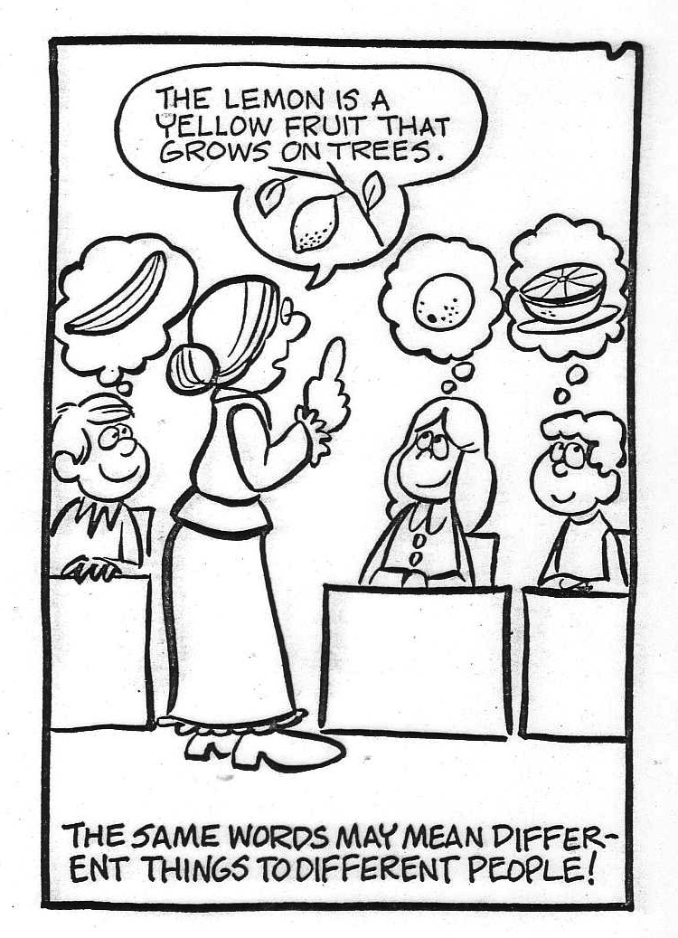
We need to define each gift
The lemon is a yellow fruit growing on trees
THE SAME WORDS MAY MEAN DIFFERENT THINGS TO DIFFERENT PEOPLE!

Slide 6
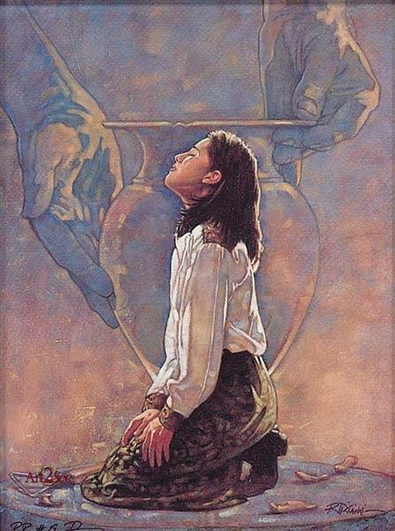
New Testament Gift Lists
6
Gifts (All) | Rom 12:6-8 | Eph 4:11 | 1 Cor 12:28 | 1 Cor 12:29-30 | 1 Cor 12:8-10
Teaching | Teaching |  | Teaching | Teaching
Evangelism |  | Evangelists
Pastor-Teacher |  | Pastor-Teachers
Exhortation | Exhortation
Administration |  |  | Administration
Faith |  |  |  |  | Faith
Giving | Giving
Service | Service |  | Helping
Showing Mercy | Mercy
Apostleship |  | Apostles | Apostles | Apostles
Wisdom |  |  |  |  | Wisdom
Knowledge |  |  |  |  | Knowledge
Prophecy | Prophecy | Prophets | Prophecy | Prophecy | Prophecy
Discerning Spirits |  |  |  |  | Discerning Spirits
Tongues |  |  | Tongues | Tongues | Tongues
Interpretation |  |  |  | Interpretation | Interpretation
Miracles |  |  | Miracles | Miracles | Miracles
Healings |  |  | Healings | Healings | Healings
Speaking
1 Pet. 4:11a
Permanent
Serving
1 Pet. 4:11b
Foundational
Eph. 2:20
Temporary
Sign
Heb. 2:4

Slide 7
1 Corinthians 13:8-12
8 Love never fails. But where there are prophecies, they will cease; where there are tongues, they will be stilled; where there is knowledge, it will pass away.
9 For we know in part and we prophesy in part,
10 but when perfection comes, the imperfect disappears.

Slide 8
1 Corinthians 13:8-12
11 When I was a child, I talked like a child, I thought like a child, I reasoned like a child. When I became a man, I put childish ways behind me.
12 Now we see but a poor reflection as in a mirror; then we shall see face to face. Now I know in part; then I shall know fully, even as I am fully known.

Slide 9
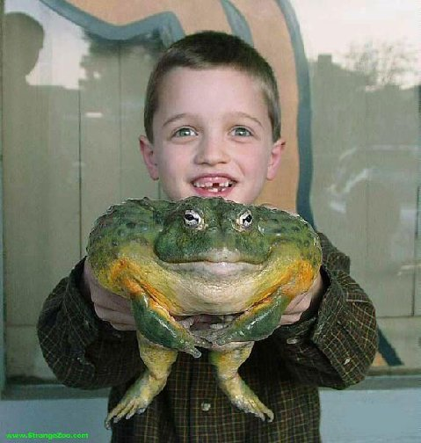
This is a mega passage!

Slide 10
1 Corinthians 13:8-13
16
______________________________________________________________________________
Crucial Questions Canon (Bible) Rapture Body (Church)
______________________________________________________________________________
13:8 What is the nature of:
a) prophecy & knowledge? revelatory non-revelatory revelatory
b) tongues? confirmatory non-confirmatory confirmatory
When do the these gifts cease? with canon at Christ's coming with canon
13:10 What is to teleion? the "complete" the "perfect" the "mature"
(the canon) (Christ's coming) (the body)
13:11 What does growth to before and after before and after before and after
manhood represent? completed canon Christ's coming body's maturity
(shown by canon)
13:12 What are partial and before and after before and after before and after
full sight and knowledge? completed canon Christ's coming body's maturity
(completed by
parousia )
________________________________________________________________________________
Robert L. Thomas, JETS (1974): 81-89

Slide 11
The Canon View of 1 Corinthians 13:8-13
16
1. The Canon View sees to teleion as "the complete, the totality," referring to "the completed Scriptures." Therefore, prophecy, knowledge and tongues ceased before the New Testament was finished and are not existing today.
Strengths
Weaknesses
a.
Revelational knowledge context (vv. 8-9).
a.
Irreconcilable with Christ's coming (the parousia) in verse 12.
b.
Confirmatory nature of tongues
(cf. 14:22).
b.
The context does not refer to a completed New Testament. It's also doubtful that Paul ever envisioned one.
c.
Contrasts with partial nature of prophecy and knowledge.
c.
"The whole" (to ek pantos) better contrasts "partial" than to teleion in that both are quantitative.
d.
to teleion often means "complete."
e.
"Complete" best contrasts "partial" (v. 10).
Robert L. Thomas, JETS (1974): 81-89

Slide 12
The Rapture View of 1 Corinthians 13:8-13
17
2. The Rapture View sees to teleion as "the perfect" (as opposed to "the complete" above), referring to the coming of Christ at the Rapture. Therefore, prophecy, knowledge and tongues will cease only when Christ comes and exist today as legitimate gifts.
Robert L. Thomas, JETS (1974): 81-89
Strengths
Weaknesses
a.
Adequately explains "knowing fully" in verse 12.
a.
Inadequately explains the gradual maturing development of verse 11.
b.
"Face to face" (v. 12) well describes seeing Christ at His coming (cf. 1 Cor. 1:7) and has OT parallels to seeing God personally.
b.
Fails to recognize the distinctions between the revelatory nature of prophecy and knowledge and the confirmatory nature of tongues (cf. 14:22)
c.
"Perfect" well describes the condition at the parousia (Rapture).
c.
Paul never uses to teleion as "the perfect" in the absolute sense.
d.
to teleion often means "perfect" in secular, philosophical Greek (e.g. Plato) as well as James 3:2.
d.
"Perfect" (a qualitative term)
poorly contrasts with "partial"
(a quantitative term, v. 10).

Slide 13
The Body View of 1 Corinthians 13:8-13
17
3. The Body View sees to teleion as "the mature," referring to the maturity of the body of Christ. "It pictures the Christian church collectively, growing up as one body, beginning with its birth, progressing through different stages.... during the present [relative maturity, v. 11] and reaching maturity at the parousia [ultimate maturity, v. 12; Thomas, 86]." By using the ambiguous to teleion Paul left open two possibilities, the church as: (1) relatively complete at the completion of the NT or (2) ultimately complete at Christ's return. This view comes to the same conclusion as the Canon View.
Strengths
Weaknesses
a.
Parallel 1 Cor. texts contrast to teleion ("mature") with "babes, child" (nepios; 2:6 & 3:1; 14:20)
a.
"Mature" (a qualitative term) poorly contrasts "partial" (a quantitative term, v. 10).
b.
Consistent with both the relative maturity of v. 11 and the absolute maturity of v. 12.
b.
Assigns a double sense for to teleion which may be unlikely.
c.
Best fits the "body and gifts context" of 1 Cor. 12-14 and the striking similarity to Eph. 4:1-16.
d.
Has the same strengths of a., b., & c. in the Canon View.
Robert L. Thomas, JETS (1974): 81-89

Slide 14
Doubting Thomases
18
71
Robert Thomas
"The Cessation of the Sign Gifts" BibSac 145 (1988): 299-315 copied on notes, 71-79
Thomas Edgar
Miraculous Gifts (1983)
Satisfied by the Promise of the Spirit (1996)

Slide 15
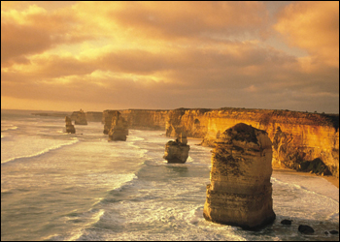
What About the Gift of Apostle?
The Twelve Apostles
(Melbourne, Australia)

Slide 16
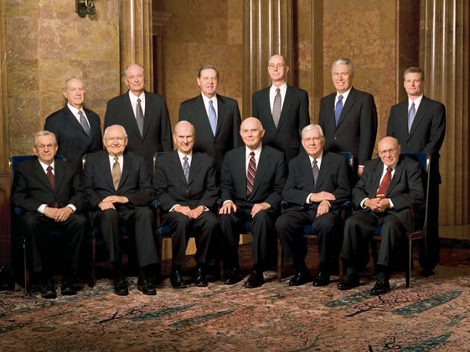
Are Apostles Living Today?
Mormons say "Yes!"

Slide 17
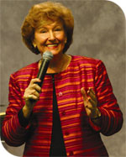
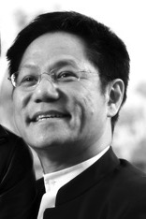

Singapore even claims its own apostles…

Slide 18
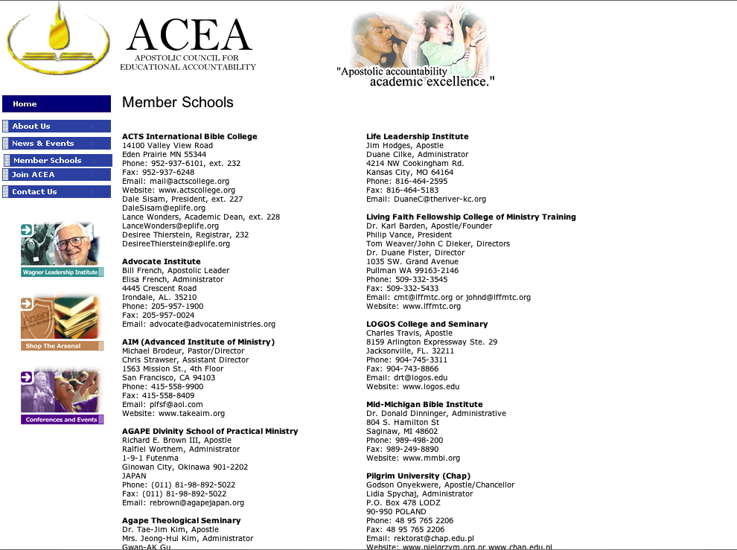
Apostolic Council for Educational Accountability
TOUCH Equipping Stations System (TESS) Lawrence Khong, Apostle
Rev. Yong Tai Tong, Director
Blk 750A Chai Chee Road #04-01
Technopark @ Chai Chee
SINGAPORE 469001
Phone: 011-65-64249400
Fax: 011-65-64249500
Email: taitong.yong@touch.org.sg
Website: www.FCBC.org.sg

Slide 19
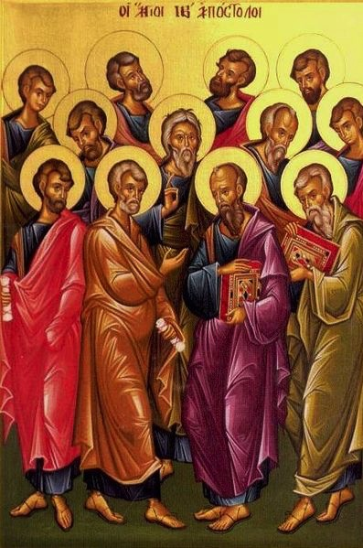
Are there apostles today?
20
God's household (the church) is:
"built on the foundation of the apostles and prophets, with Christ Jesus himself as the chief cornerstone"
(Eph. 2:20)

Slide 20

God's Household (Eph. 2:19-22)
19
Non-Equipping Gifts
(Eph. 4:12b)
Pastor-Teachers
Evangelists
Teachers
Equipping Gifts
(Eph. 4:11-12a)
Foundation: Apostles & Prophets (Eph 2:20)
Foundation: The Lord Jesus Christ (1 Cor. 3:11)
Adapted from Charles R. Swindoll. "Spiritual Gifts Study Guide" (IFL, 1983), 7

Slide 21
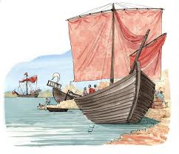
Greek Origin of the Word "Apostle"
apostolos
In classical Greek: usage confined mainly to seafaring contexts.
⇒ Derived from the verb, apostello ("I send")
⇒ Often meant a "ship," "fleet," "naval expedition," or "naval commander," but rarely a person sent
In biblical NT Greek: messenger; envoy; Apostle

Slide 22
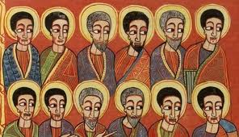
NT Usage of the word "Apostle"
20
The Twelve Disciples plus Paul:
"apostles" (Luke 6:13; 9:10; 1 Cor. 15:5), including Matthias (Acts 1:23-26)
Paul was deemed an "apostle" later
(Gal. 1:1, 12, 15-17).

Slide 23
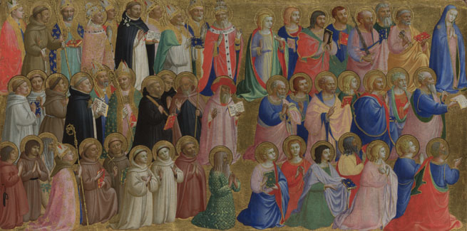
NT Usage of the word "Apostle"
20
Church Planters Other than "The Twelve":
"All the apostles" who saw Christ resurrected (1 Cor. 15:7) probably indicates more persons than the Twelve (v. 5) and may include Barnabas (Acts 14:4, 14), Jesus' brother James (Gal. 1:19), Andronicus and Junias (Rom. 16:7), Silvanus (Silas) and Timothy (1 Thess. 1:1; 2:6-7), and Apollos (1 Cor. 4:6, 9).

Slide 24
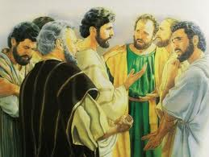
NT Usage of the word "Apostle"
20
Missionaries:
"messengers" (2 Cor. 8:23; Phil. 2:25)
"one who is sent" (John 13:16)

Slide 25
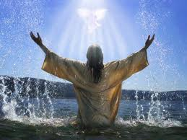
NT Usage of the word "Apostle"
20
Jesus as "Apostle":
"Therefore, holy brethren, partakers of a heavenly calling, consider Jesus, the Apostle and High Priest of our confession"
(Heb. 3:1 NAU)

Slide 26
Apostle Job Description
20
Chosen directly by Christ (Luke 6:13) or Spirit (Acts 13:2)
Had miraculous powers (2 Cor. 12:11-12)
Received direct revelation (Gal. 1:12)
Unquestioned authority (1 Cor. 4:19-21)
Laid the Church's foundation (Eph. 2:20)
Saw Christ personally (1 Cor. 9:1)
Most influential office (1 Cor. 12:28)
Equipped the saints for ministry (Eph. 4:11-12)

Slide 27
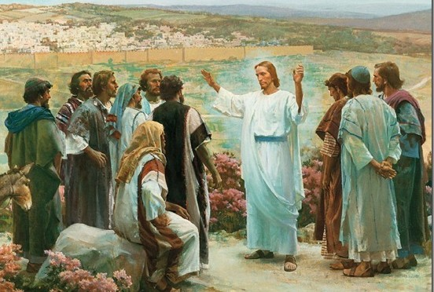
Definition of Apostleship
Is defined in various ways:
the OFFICE of Apostleship (Acts 1:25)
• proponents: Grudem and Erickson
the SPIRITUAL GIFT of apostleship
(1 Cor. 12:28; Eph. 4:11)
• proponent: Geisler
3) Both an OFFICE & GIFT • proponent: Griffith

Slide 28
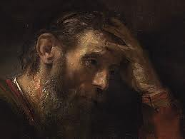
What is the gift of apostleship?
20
"The divinely ordained gift to establish the Church on earth by divine revelation, unquestioned authority, and authentication by miracles."

Slide 29
Functions of Apostles
Apostles had a unique function and authority:
They were given authority (Mark 6:7) and power (Acts 1:8) to proclaim the gospel and for use in the church (Acts 4:33; 2 Cor. 10:8; 13:10)
(ii) The Church is said to be founded upon the apostles and prophets (Eph. 2:20)
(iii) Their authority was shown in the exercise of church discipline (Acts 5:1-11; 1 Cor. 5:1-5) and oversight (Acts 15:36; 1 Cor. 4:15).
⇒ major decisions are made through a council of apostles and elders (Acts 15:6)

Slide 30
Functions of Apostles
(iv) The apostles appointed elders (Acts 14:23) and ordained elders/deacons in the early church (Acts 6:3, 6)
(v) Their functions are to preach (Acts 2:42), to teach (2:42), to heal (5:12), to administer certain work (4:37), though it was not to get out of hand (6:1-4)
(vi) They were given the authority by Holy Spirit to speak and write what became NT scripture

Slide 31
Functions of Apostles
(vii) Jesus promised special gifts to Apostles (John 14:26; 16:13-14)
(viii) They could perform signs, wonders and miracles (2 Cor. 12:12)
(ix) They are believed to be equal in authority to that of the OT prophets, as a representative from God.
Therefore, to disbelieve and disobey the Apostle's words was equivalent to disbelieving and disobeying God!

Slide 32
Some questions to think about
Looking at Paul and his example, there are people who claim to also have had unique, personal, supernatural encounters with Jesus.
⇒ So what about them? Can they call themselves apostles too?
One difficulty of proving one's call to the office of apostleship is that it has to be a personal call from Christ to the recipient.
⇒ What if someone today says that he receives this very special call from the Lord himself? How would you respond to this?
Should we use the term "apostle" widely to mean someone being sent out, by the church? Or even see that person as a messenger of God's message to the mission field?
What about those organizations that confer the title of "Apostle" to certain individuals, such as is the case here in Singapore?
What do you think?

Slide 33
So are there Apostles Today?
"Apostleship" – either an office or a spiritual gifting
As an office: NO, it is closed!
- the narrow and solemn definition applies here, thus apostleship is limited to the time when the early church was founded and so, the office is closed and there can be no more apostles today!
As a spiritual gifting: POSSIBLE
- the broader and non-technical definition applies here, where the essence is that of a messenger - one who is sent out to pass on the Gospel message today. Thus we have new terms like "missionary apostles."
Do You Agree?
I don't as the second group are missionaries––not apostles

Slide 34
Word of Wisdom & Word of Knowledge
21
22
What are these gifts?

Slide 35
Gifts in Order of Importance
21
22
1 Cor. 12:8
Word of wisdom
Word of knowledge
1 Cor. 12:28
Apostles
Prophets
Teachers

Slide 36
Defining Word of Wisdom
21
"The gift of receiving, knowing, and presenting the wisdom of God, the revealed truth of God, as presented by the apostles and prophets, as contained in … our NT" (McRae, 65)

Slide 37
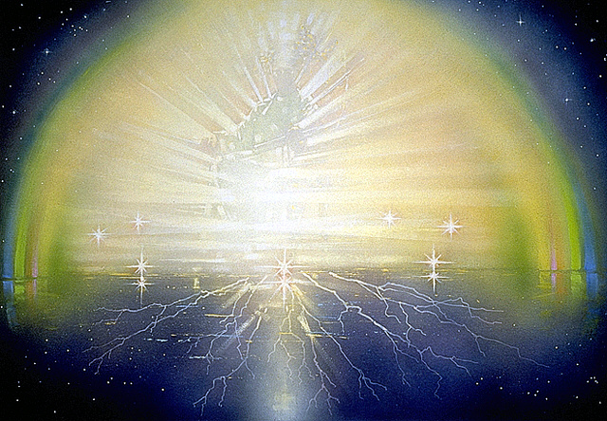
I. The gospel is God's secret message of wisdom that the world rejects
(1 Cor. 2:6-10).

Slide 38
A. Believers do speak wisdom––God's wisdom (2:6 NLT)
6 Yet when I am among mature Christians, I do speak with words of wisdom, but not the kind of wisdom that belongs to this world, and not the kind that appeals to the rulers of this world, who are being brought to nothing.

Slide 39

B. Only believers understand
God's wisdom (7-10)
"but we speak God's wisdom in a mystery…" (2:7 NASB)
• secret (7a)

Slide 40

Top Secret

Slide 41
God's wisdom is secret (2:7a NLT)
7 No, the wisdom we speak of is the secret wisdom of God, which was hidden in former times, though he made it for our benefit before the world began.
Secret Wisdom =
Christ (1:24, 30) crucified (2:2)

Slide 42
B. Only believers understand
God's wisdom (7-10)
"but we speak God's wisdom in a mystery…" (2:7 NASB)
• secret (7a)
• hidden (7b)

Slide 43
The wisdom of Christ crucified was hidden (2:7b NLT)
7 No, the wisdom we speak of is the secret wisdom of God, which was hidden in former times, though he made it for our benefit before the world began.

Slide 44
B. Only believers understand
God's wisdom (7-10)
"but we speak God's wisdom in a mystery…" (2:7 NASB)
• secret (7a)
• predestined (7c)
• hidden (7b)

Slide 45
Christ crucified was predestined
(2:7c NLT)
7 No, the wisdom we speak of is the secret wisdom of God, which was hidden in former times, though he made it for our benefit before the world began.

Slide 46
B. Only believers understand
God's wisdom (7-10)
"but we speak God's wisdom in a mystery…" (2:7 NASB)
• secret (7a)
• predestined (7c)
• hidden (7b)
• misunderstood (8)

Slide 47
God's wisdom is misunderstood (2:8 NLT)
8 But the rulers of this world have not understood it; if they had, they would never have crucified our glorious Lord.

Slide 48
B. Only believers understand
God's wisdom (7-10)
"but we speak God 's wisdom in a mystery…" (2:7 NASB)
• secret (7a)
• predestined (7c)
• hidden (7b)
• misunderstood (8)
• not even thought about (9-10)

Slide 49
God's wisdom in Christ is not even thought about (2:9-10 NLT)
9 That is what the Scriptures mean when they say, "No eye has seen, no ear has heard, and no mind has imagined what God has prepared for those who love him."
10 But we know these things because God has revealed them to us by his Spirit, and his Spirit searches out everything and shows us even God's deep secrets.

Slide 50
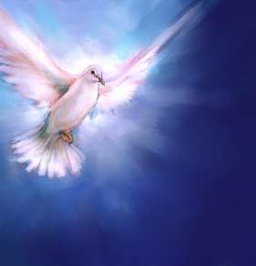
II. Only believers have God's wisdom because only believers have the Spirit
(2:11-16).

Slide 51
A. No one knows what someone else is thinking (2:11 NLT)
11 No one can know what anyone else is really thinking except that person alone, and no one can know God's thoughts except God's own Spirit.

Slide 52
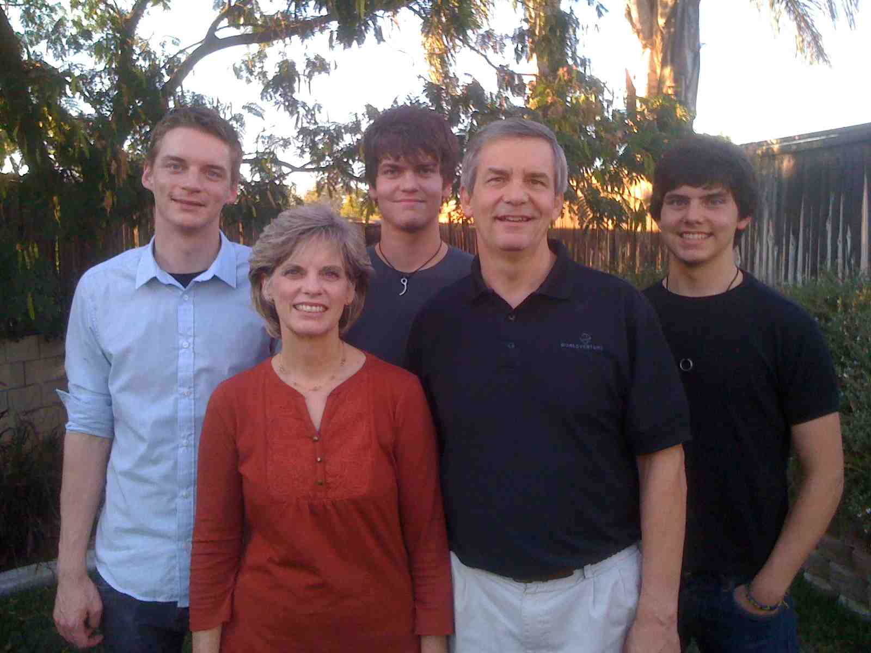
My Three Sons

Slide 53
B. God gave us His Spirit to teach us spiritual truth (2:12-13 NLT)
12 And God has actually given us his Spirit (not the world's spirit) so we can know the wonderful things God has freely given us. ¹³When we tell you this, we do not use words of human wisdom. We speak words given to us by the Spirit, using the Spirit's words to explain spiritual truths.

Slide 54
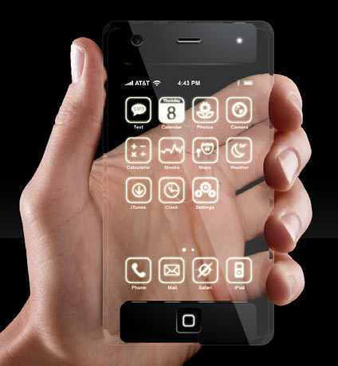

We Need Gadget Instructions
How much more God’s wisdom?

Slide 55


"We Preach Christ Crucified"

Slide 56
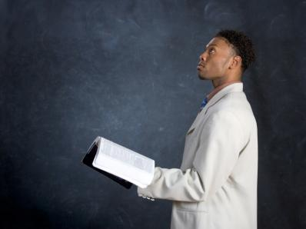
C. Unbelievers don't understand God's wisdom while Christians do (2:14-16).

Slide 57
A non-Christian thinks spiritual truth is foolish since he doesn't have the Spirit teaching him (2:14 NLT)
14 But people who aren't Christians can't understand these truths from God's Spirit. It all sounds foolish to them because only those who have the Spirit can understand what the Spirit means.

Slide 58
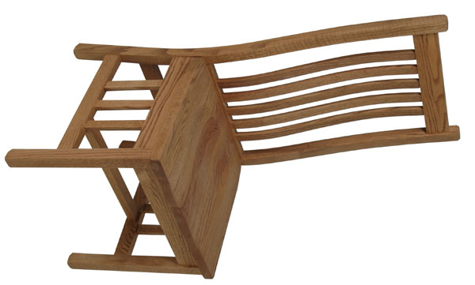
Who sits in your chair?

Slide 59

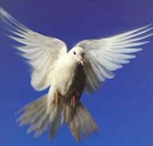
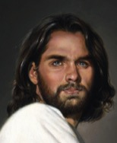
Types of People
?
?
Self
?
"Man without the Spirit"
(Non-Christian)
2:14

Slide 60
We can make intelligent spiritual decisions since Christ instructs us (1 Cor. 2:15 NLT)
15 We who have the Spirit understand these things, but others can't understand us at all.

Slide 61
Types of People
?
?
Self
?
Self
"Man without the Spirit"
(Non-Christian)
2:14
"The Spiritual Man"
(Christian)
2:15

Slide 62
We can't teach God but He can teach us (2:16 NLT)
16 How could they? For, "Who can know what the Lord is thinking? Who can give him counsel?" But we can understand these things, for we have the mind of Christ.

Slide 63
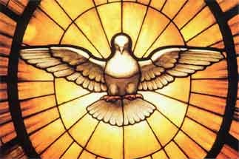
The Focal Point of the Text
We can be truly united as a church by focusing on
God's wisdom

Slide 64

What does God's wisdom look like?
Unity
Humility
Witnessing
Character
Bible

Slide 65

We need God's wisdom

Slide 66
Defining Word of Knowledge
22
The first century teacher's divine enablement to understand, expound, and apply doctrinal truth (possibly received by direct revelation from God)

Slide 67

Holy Spirit PPT link at BibleStudyDownloads.org
Get this presentation for free!

Slide 68
Black

